Slide 1

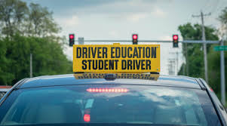
Driver’s Education
Instructor Course
Presented by MDPS Legal Department

Slide 2
Key Topics
Litter Laws
Squatted vehicles
Traffic Stops
DUI, brief introduction
Rules of the Road, but not all of them

Slide 3
Littering with substance likely to ignite grass
§97-15-29
Anyone who throws, dumps, or leaves on the roads and highways or upon any private property, any cigarette or cigar stub or anything else that is likely to ignite grass can be fined $50-$250 AND be required to perform community service picking up trash.
This fine will also include other assessments, including an extra $50 to be deposited in the Law Enforcement Officers Monument Fund
Any litter thrown from the vehicle is attributed to the driver

Slide 4
Littering with substance likely to ignite grass
§97-15-29
Subsequent convictions of this offense double the minimum and maximum fine

Slide 5
Solid Waste Disposal
§97-15-30
Same fine as 97-15-29 (last slide)
Anything other than an item that is likely to ignite grass falls under this statute
The more the litter weighs, the more the driver pays in fines

Slide 6
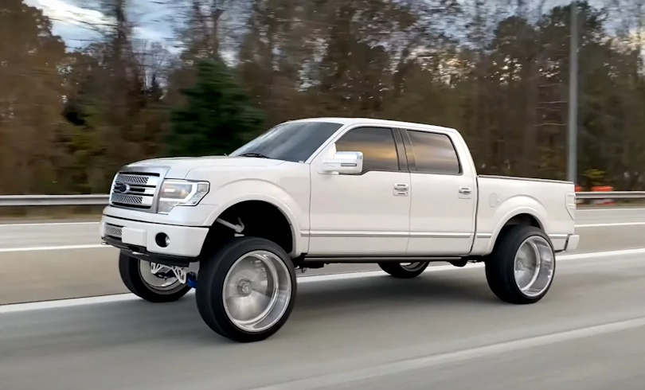
Squatted Vehicles

Slide 7
"Squatted" Vehicles
63-7-105 (1). Fenders
(1) For purposes of this section:
(a) The height of the fender shall be a vertical measurement from, and perpendicular to, the ground, through the centerline of the wheel, and to the bottom of the fender.
(b) "Fender" means the pressed and formed part mounted over the road wheels of a motor vehicle to reduce the splashing of mud, water or similar substances.
(c) "Squatted vehicles" means vehicles whose front fenders have been raised four (4) or more inches greater than the rear fenders. The described modification makes a vehicle appear as if it is "squatting" on its back tires.

Slide 8
"Squatted" Vehicles
63-7-105 (2). Fenders
(2)(a) It shall be unlawful for any person to drive a passenger motor vehicle on the streets or highways of this state if, by alteration of the suspension, frame or chassis, the height of the front fender is raised four (4) or more inches greater than the height of the rear fender.
  (b) Motor vehicles equipped with high clearance fenders to allow for increased front suspension articulation shall be exempt from the provision of paragraph (a) of this subsection.

Slide 9
"Squatted" vehicles
63-7-105 (3). Fenders
(3) A person who violates the provisions of this subsection is guilty of a misdemeanor and, upon conviction:
(a) For a first offense, shall be fined One Hundred Dollars ($100.00);
(b) For a second offense, shall be fined Two Hundred Dollars ($200.00); and
(c) For a third or subsequent offense, shall be fined Three Hundred Dollars ($300.00) and have his or her license suspended by the Commission of Public Safety for a period of twelve (12) months from the date of conviction.

Slide 10
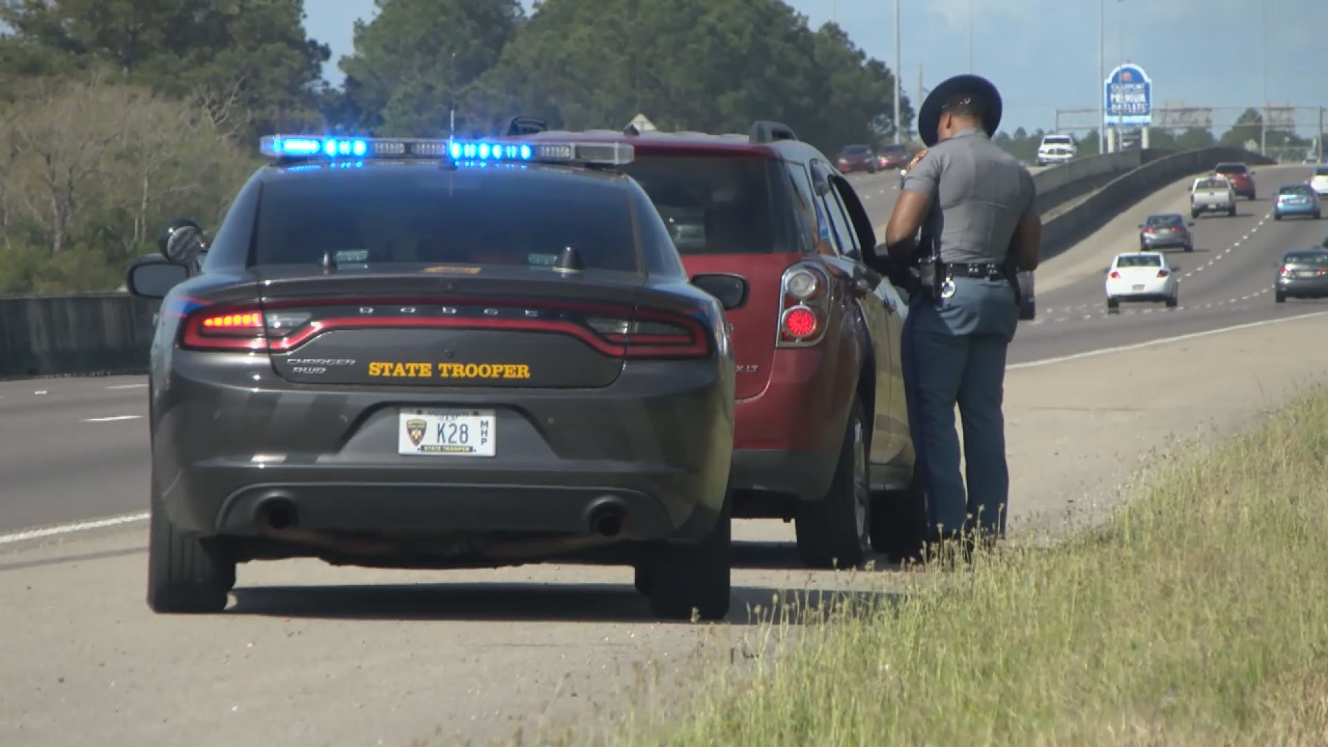
What to Do When Being Pulled Over by Law Enforcement

Slide 11
What to Do and Expect When Pulled Over by Law Enforcement
Law Enforcement officers are responsible for conducting traffic stops when they have reasonable suspicion of a traffic violation or a criminal violation.
Being stopped by an officer can be a stressful experience for the driver, any passengers, and for the officer.

Slide 12
What to Do and Expect When Pulled Over by Law Enforcement
Knowing what to do during the stop will help ensure your safety and the safety of others.
When you see emergency lights behind you, it is important for you and your passengers to stay calm and cooperate.

Slide 13
What to Do and Expect When Pulled Over by Law Enforcement
Activate your turn signal and pull off or to the side of the roadway as soon as it is safe to do so.
• Turn off the engine and any audio devices.
• Stay in your vehicle unless directed by the officer to exit.

Slide 14
What to Do and Expect When Pulled Over by Law Enforcement
• Turn on your interior lights if you are pulled over at night to assist with visibility. Officers may use a spotlight for additional visibility.
• Keep your hands on the steering wheel or in a visible location so they are easily observable.
• Follow all instructions the officer gives you or your passengers.

Slide 15
What to Do and Expect When Pulled Over by Law Enforcement
The officer may approach either side of the vehicle. When the officer approaches the vehicle, remember to:
• Lower the corresponding window so you and the officer can better communicate.
• Let the officer know if you have a weapon in the vehicle upon first contact.
• Wait for the officer’s instructions before reaching for your driver’s license or vehicle documents.

Slide 16
What to Do and Expect When Pulled Over by Law Enforcement
When conducting the stop, the officer will typically:
• Explain why you were stopped/ask questions about your trip.
• Ask for your driver’s license, proof of insurance, and vehicle registration. If the documents are out of your reach, tell the officer where they are and wait for the officer’s acknowledgment before reaching to retrieve the documents.
• Show their law enforcement credentials if they are not in uniform. If they do not show their credentials, you may ask to see them.

Slide 17
What to Do and Expect When Pulled Over by Law Enforcement
In some cases, the officer may:
• Ask you to exit the vehicle. In this case, keep your hands visible, exit the vehicle, and stand in a location as directed by the officer.
• Take any one of many possible actions, including but not limited to, issuing a warning, issuing a traffic ticket, or making an arrest. The officer will typically explain whatever action is being taken. If they do not, you may ask them to do so.

Slide 18
What to Do and Expect When Pulled Over by Law Enforcement
If you have questions, respectfully ask the officer to clarify.
If you disagree with the officer’s decision or course of action, do not prolong the contact by arguing with the officer.
Rather, you may seek to contest the decision in court through established legal channels.
Your acceptance and signature on a traffic ticket is not an admission of guilt.

Slide 19
What to Do and Expect When Pulled Over by Law Enforcement
If you believe the officer acted inappropriately or have questions regarding their conduct, you may call or contact the officer’s agency and request to speak to a supervisor. This is best done as soon as possible after the stop.
Following these procedures can help make a traffic stop a safe experience for all parties involved.

Slide 20
What is required of the driver?
§63-1-41
Every licensee shall have the required license in his immediate possession at all times when operating a motor vehicle and shall display the same, upon demand of a justice court judge, a peace officer or license examiner or other authorized employee of the commissioner.

Slide 21
What if the driver simply does not have a license?
§63-1-5
Operating a motor vehicle without a license is a misdemeanor offense punishable by:
-jail (2 days to 6 months)
-or fine ($200-$500)
-Or both

Slide 22
Driving Under the Influence
Driving under the influence of alcohol or drugs is illegal in Mississippi.
Mississippi’s Implied Consent Law provides the legal consequences of driving under the influence of alcohol and other drugs.

Slide 23
Driving Under the Influence
Driving under the influence of alcohol is extremely dangerous. Alcohol can affect your personality, temperament, and judgment. Tests show that even two beers can markedly decrease a person’s reflexes and reaction time.
If your reactions slow down only a half-second, and you need to hit the brakes while traveling fifty-five miles per hour, your vehicle will travel an extra forty-four feet before stopping. That additional distance could be the difference between life and death.
If you drink alcohol, do not drive a vehicle.
Never let another person who has consumed alcohol get behind the wheel of a vehicle.

Slide 24
Driving Under the Influence - marijuana
Marijuana, like alcohol and other drugs including prescription medication, slows down reflexes and impairs judgment.
Smoking medical cannabis in a motor vehicle or operating or being in actual physical control of any motor vehicle while under the influence is a violation of Mississippi’s laws and can result in arrest.
Driving under the influence of any drug – including medical cannabis and other prescription drugs – impairs a driver’s ability to operate a motor vehicle and can result in arrest.

Slide 25
Implied Consent
When you operate a motor vehicle in the state of Mississippi, you are giving your implied consent to testing for the presence of intoxicating substances in your body.
This means that if a law enforcement officer has good reason to suspect that you are operating your vehicle under the influence of an intoxicating substance, the officer can request you take a breath or chemical test. These tests measure your blood alcohol content (BAC).

Slide 26
Implied Consent
What if I refuse to take a breath or chemical test?
You have the right to refuse the officer’s request. If you refuse:
You must surrender your driver’s license to the officer immediately.
The officer will give you an official receipt for your license, which will serve as your temporary permit to drive, valid for only forty-five days.

Slide 27
Implied Consent
The officer will forward your driver’s license, along with the officer’s sworn report, to the Commissioner of Public Safety, who will review your case.
Your license will be administratively suspended for ninety days for
refusing the breath or chemical test. Suspension times increase for
subsequent refusals resulting in a conviction or non-adjudication.

Slide 28
DUI
How much is too much?
Under the Influence of intoxicating alcohol if:
  21 years old or older BAC registers .08% or more
  under the age of 21 BAC registers .02% or more.
If your blood alcohol content reaches or exceeds your minimum limit, the officer will demand your license. The officer will give you an official receipt for your license, which will serve as your temporary permit to drive, valid for only 30 days.

Slide 29
RULES OF THE ROAD
Title 63, Chapter 3 is also cited as:
“Uniform Highway Traffic Regulation Law”
more commonly referred to as
RULES OF THE ROAD

Slide 30
RULES OF THE ROAD
For the safety of all drivers, a few rules have been selected for you to share with students in your classes

Slide 31
License Plate Obscurement
“Any person who defaces, covers or obstructs any portion of a license tag with any sticker, decoration, paint, marking, license plate bracket or holder or any other thing or device, in such a manner that the characters and any legally affixed decals on the tag cannot be read, shall be guilty of a misdemeanor and, upon conviction, shall be punished by a fine of not more than Twenty-five Dollars ($25.00).”
“However, it shall not be unlawful for the county name to be partially or completely obstructed from view by any object, decal, sticker or license plate bracket or holder.”
§27-19-31

Slide 32
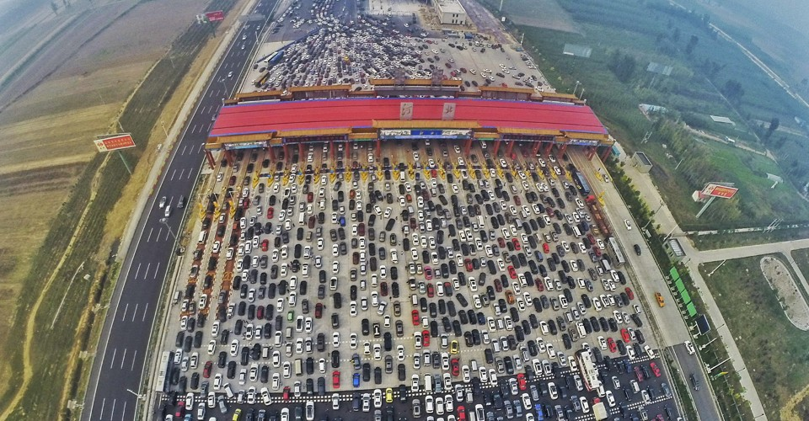
§ 63-3-123. Traffic
“Traffic” means pedestrians, ridden or herded animals, vehicles, street cars, and other conveyances either singly or together while using any highway for purposes of travel.

Slide 33
§ 63-3-125. Types of road
(a) “Street or highway” means the entire width between property lines of every way or place of whatever nature when any part thereof is open to the use of the public, as a matter of right, for purposes of vehicular traffic.
(b) “Laned highway” means a highway the roadway of which is divided into three or more clearly marked lanes for vehicular traffic.
(c) “Roadway” means that portion of a highway improved, designed, or ordinarily used for vehicular travel.
(d) “Sidewalk” means that portion of a street between curb lines, or the lateral lines of a roadway, and the adjacent property lines intended for the use of pedestrians.
(e) “Private road or driveway” means every way or place in private ownership and used for vehicular travel by the owner and those having express or implied permission from the owner but not by other persons.
(f) “Through highway” means every highway or portion thereof at the entrances to which vehicular traffic from intersecting highways is required by law to stop before entering or crossing the same and when stop signs are erected as provided in this chapter.

Slide 34
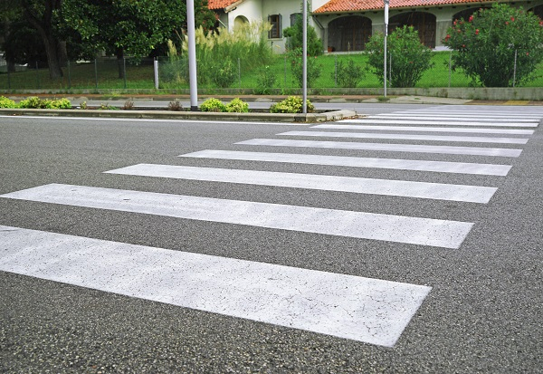
§ 63-3-127. Crosswalk
“Crosswalk” means that portion of a roadway ordinarily included within the prolongation or connection of the lateral lines of sidewalks at intersections, or any portion of a roadway distinctly indicated for pedestrian crossing by lines or other markings on the surface.

Slide 35
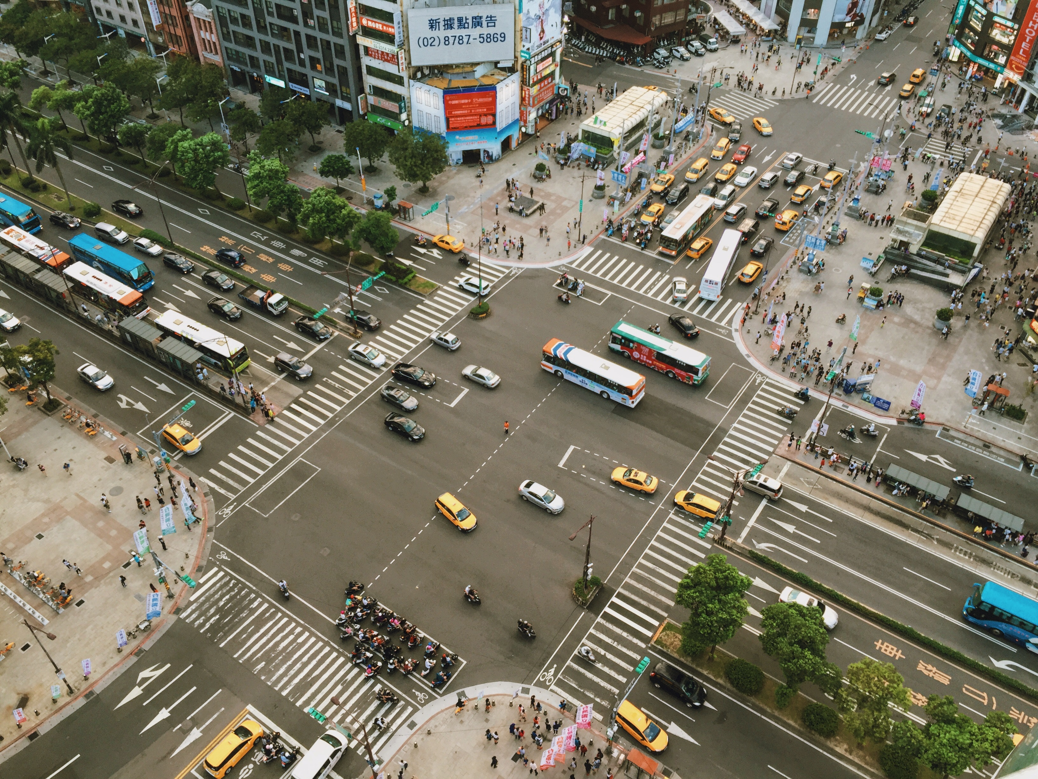
§ 63-3-129. Intersection
“Intersection” means the area embraced within the prolongation or connection of the lateral curb lines, or, if none, then the lateral boundary lines of the roadways of two highways which join one another at or approximately at, right angles, or the area within which vehicles traveling upon different highways joining at any other angle may come in conflict.

Slide 36
§ 63-3-131. Safety zone
“Safety zone” means the area or space officially set apart within a roadway for the exclusive use of pedestrians and which is protected or is so marked or indicated by adequate signs as to be plainly visible at all times while set apart as a safety zone.

Slide 37
§ 63-3-133. Traffic control mergers
(a) “Official traffic-control devices” means all signs, signals, markings, and devices not inconsistent with this chapter placed or erected by authority of a public body or official having jurisdiction, for the purpose of regulating, warning, or guiding traffic.
(b) “Official traffic-control signal” means any device, whether manually, electrically or mechanically operated, by which traffic is alternately directed to stop and to proceed.
(c) “Railroad sign or signal” means any sign, signal, or device erected by authority of a public body or official or by a railroad and intended to give notice of the presence of railroad tracks or the approach of a railroad train.

Slide 38
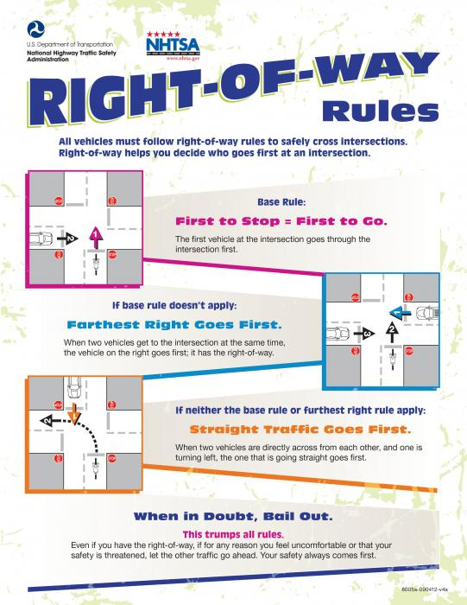
§ 63-3-135
Right-of-way
“Right-of-way” means the privilege of the immediate use of the highway.

Slide 39
§ 63-3-502
Racing motor vehicles or motorcycles on streets or highways; prohibition; definitions; penalties
(1 of 2)
Any person driving a motor vehicle or motorcycle upon a street or highway in a race, upon conviction, shall be punished as follows:
A person convicted for the 1st offense of violating this subsection shall be:
  fined $250.00 - $1,000.00
  Jail for no more than 2 days
  Or Both.
For a 2nd conviction of any person violating this subsection, both within 5 years, the person shall be:
  fined $600.00 - $1,500.00,
  shall be imprisoned not less than 5 days nor more than 1 year,
  and shall be sentenced to community service work for not less than 10 days nor more than 1 year.

Slide 40
§ 63-3-502
Racing motor vehicles or motorcycles on streets or highways; prohibition; definitions; penalties
(2 of 2)
For a 3rd, 4th, etc. (subsequent) conviction of any person violating this subsection, the offenses being committed within a period of 5 years,
  the person shall be guilty of a felony and
  fined $2,000.00-$5,000.00,
  and shall serve not less than 1 year nor more than 5 years in the custody of the Department of Corrections; however, for any such offense that does not result in serious injury or death to any person, the sentence of incarceration may be served in the county jail at the discretion of the circuit court judge.
  Commissioner of Public Safety shall suspend the driver’s license and driving privileges of the person for not less than 5 years.

Slide 41
§ 63-3-505
Required speed reductions
The driver of any motor vehicle must decrease speed
when approaching and crossing an intersection,
when approaching and going around a curve,
when approaching a hill crest,
when traveling upon any narrow or winding roadway, or
when special hazard exists with respect to pedestrians or other traffic.
All trucks, or truck-trailer combinations and passenger buses shall be required to reduce speed to 45 miles per hour during inclement weather when visibility is bad.

Slide 42
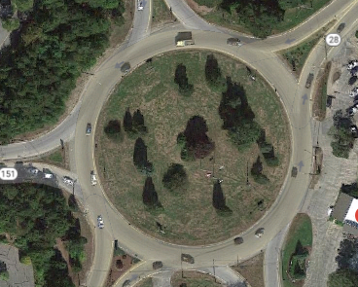
§ 63-3-605. One-way roads and rotaries
(2) A vehicle passing around a rotary traffic island shall be driven only to the right of such island.

Slide 43
§ 63-3-615. Stopped school buses (1 of 3)
(1)(a) The driver of a vehicle upon a street or highway upon meeting or overtaking any school bus that has stopped on the street or highway for the purpose of receiving or discharging any school children shall come to a complete stop at least ten (10) feet from the school bus before reaching the school bus when there is in operation on the school bus the flashing red lights provided in Section 63-7-23, or when a retractable, hand-operated stop sign is extended; the driver shall not proceed until the children have crossed the street or highway and the school bus has resumed motion or the flashing red lights are no longer actuated and the hand-operated stop sign is retracted.
(b) The driver of a vehicle upon a divided highway that has four (4) lanes or more and permits at least two (2) lanes of traffic to travel in opposite directions need not stop upon meeting or passing a school bus that is stopped in the opposing roadway, or if the school bus is stopped in a loading zone that is a part of or adjacent to the highway and where pedestrians are not permitted to cross the roadway.

Slide 44
§ 63-3-615. Stopped school buses (2 of 3)
(2)(a) Except as provided in paragraph (b), any person violating the provisions of subsection (1) of this section shall be guilty of a misdemeanor and upon a first conviction thereof shall be fined not less than Three Hundred Fifty Dollars ($350.00) nor more than Seven Hundred Fifty Dollars ($750.00), or imprisoned for not more than one (1) year, or both. For a second or subsequent offense, the offenses being committed within a period of five (5) years, the person shall be guilty of a misdemeanor and, upon conviction, shall be fined not less than Seven Hundred Fifty Dollars ($750.00) nor more than One Thousand Five Hundred Dollars ($1,500.00), or imprisoned for not more than one (1) year, or both. In addition, the Commissioner of Public Safety or his duly authorized designee, after conviction for a second or subsequent offense and upon receipt of the court abstract, shall suspend the driver's license and driving privileges of the person for a period of ninety (90) days.
(b) A conviction under this section for a violation resulting in any injury to a child who is in the process of boarding or exiting a school bus shall be a violation of Section 97-3-7, and a violator shall be punished under subsection (2) of that section.
(3) This section shall be applicable only in the event the school bus shall bear upon the front and rear thereon a plainly visible sign containing the words “school bus” in letters not less than four (4) inches in height.

Slide 45
§ 63-3-615. Stopped school buses (3 of 3)
(4) If any person witnesses the driver of any vehicle violating the provisions of this section and the identity of the driver of the vehicle is not otherwise apparent, it shall be a rebuttable inference that the person in whose name the vehicle is registered committed the violation. If charges are filed against multiple owners of a motor vehicle, only one (1) of the owners may be convicted and court costs may be assessed against only one (1) of the owners. If the vehicle that is involved in the violation is registered in the name of a rental or leasing company and the vehicle is rented or leased to another person at the time of the violation, the rental or leasing company may rebut the inference of guilt by providing the law enforcement officer or prosecuting authority with a copy of the rental or lease agreement in effect at the time of the violation.

Slide 46
§ 63-3-617. Refusal to clear center
It shall be unlawful for the driver of any truck or other vehicle to drive in or near the center of any highway for a distance of more than two hundred yards, or at any time to refuse to turn to the right in order that any driver desiring to pass said truck or other vehicle, may drive at a higher legal rate of speed.
You may not cruise in the turning lane.

Slide 47
§ 63-3-619. Tailgating
(1) The driver of a motor vehicle shall not follow another vehicle more closely than is reasonable and prudent, having due regard for the speed of such vehicles and the traffic upon and the condition of the highway.
(2) The driver of any motor truck or motor truck drawing another vehicle when traveling upon a roadway outside of a business or residence district shall not follow within three hundred feet of another motor truck or motor truck drawing another vehicle. The provisions of this subsection shall not be construed to prevent overtaking and passing nor shall the same apply upon any lane specially designated for use by motor trucks.

Slide 48
§ 63-3-621. Following fire apparatus or ambulance
The driver of any vehicle other than one on official business shall not follow any fire apparatus traveling in response to a fire alarm closer than five hundred (500) feet or drive into or park such vehicle within the block where fire apparatus has stopped in answer to a fire alarm. The driver of any vehicle other than an official emergency vehicle shall not follow any moving ambulance that is engaged in an emergency medical call closer than five hundred (500) feet, or park the vehicle within two hundred (200) feet of where the ambulance has stopped to pick up or deliver a patient or otherwise render care at the scene of an ambulance call.

Slide 49
§ 63-3-809. Yielding to and approaching emergency vehicles
(1) Upon the immediate approach of an authorized emergency vehicle, when the driver is giving audible signal by siren, exhaust whistle, or bell, the driver of every other vehicle shall yield the right-of-way and shall immediately drive to a position parallel to, and as close as possible to, the right-hand edge or curb of the roadway clear of any intersection and shall stop and remain in such position until the authorized emergency vehicle has passed, except when otherwise directed by a law enforcement officer.
(2) Upon approaching a stationary authorized emergency vehicle, when such vehicle is giving a signal by use of flashing, blinking, oscillating or rotating lights, as authorized under Section 63-7-19, a person who drives an approaching vehicle shall:
(a) Proceeding with due caution, yield the right-of-way by making a lane change into a lane not adjacent to that of the authorized emergency vehicle, if possible with due regard to safety and traffic conditions, if on a roadway having at least four (4) lanes with not less than two (2) lanes proceeding in the same direction as the approaching vehicle; or
(b) Proceeding with due caution, reduce the speed of the vehicle, maintaining a safe speed for road conditions and being prepared to stop, if changing lanes would be impossible or unsafe.

Slide 50
§ 63-3-809. Yielding to and approaching emergency vehicles (cont…)
(3) Upon approaching a stationary recovery vehicle, utility service vehicle, sanitation vehicle, or highway maintenance vehicle, when the stationary vehicle is giving a signal by use of authorized flashing lights, a person who drives an approaching vehicle shall:
(a) Proceeding with due caution, yield the right-of-way by making a lane change into a lane not adjacent to the stationary vehicle, if possible, with due regard to safety and traffic conditions, if on a roadway having at least four (4) lanes with not less than two (2) lanes proceeding in the same direction as the approaching vehicle; o
(b) Proceeding with due caution, reduce the speed of the vehicle, maintaining a safe speed for road conditions and being prepared to stop, if changing lanes would be impossible or unsafe.
(4) For purposes of this section, unless the context otherwise clearly requires:
(a) “Highway maintenance vehicle” means a vehicle used for the maintenance of highways and roadways in this state and is:
(i) Owned or operated by the Department of Transportation, a county, a municipality or other political subdivision of this state; or
(ii) Owned or operated by a contractor under contract with the Department of Transportation, a county, a municipality or other political subdivision of this state.
(b) “Recovery vehicle” means a truck that is specifically designed for towing a disabled vehicle or a combination of vehicles.

Slide 51
§ 63-3-809. Yielding to and approaching emergency vehicles (cont…)
(c) “Utility service vehicle” means a vehicle used by any person, municipality, county, electric cooperative, corporation, board, commission, district or any entity created or authorized by public act, private act or general law to provide electricity, natural gas, water, wastewater services, telecommunications services or any combination thereof, for sale to consumers in any particular service area, or by any contractor under contract with any such entity.
(d) “Sanitation vehicle” means a vehicle used to collect solid waste, refuse or recyclable material that is:
(i) Owned or operated by a county, a municipality or other political subdivision of this state; or
(ii) Owned or operated by a contractor under contract with a county, a municipality or other political subdivision of this state.
(5) Upon approaching a vehicle that is marked with some combination of white flashing strobe or amber and red lights, as provided in Section 63-7-19, that is operated by a United States rural mail carrier for the purpose of delivering United States mail, and that is stationary, including when the vehicle is signaling the intention to enter the roadway, a person who drives an approaching vehicle shall:
(a) Proceeding with due caution, yield the right-of-way by making a lane change into a lane not adjacent to the stationary vehicle, if possible, with due regard to safety and traffic conditions, if on a roadway having at least four (4) lanes with not less than two (2) lanes proceeding in the same direction as the approaching vehicle; o

Slide 52
§ 63-3-809. Yielding to and approaching emergency vehicles (cont…)
(b) Proceeding with due caution, reduce the speed of the vehicle, maintaining a safe speed for road conditions and being prepared to stop, if changing lanes would be impossible or unsafe.
(6) A violation of this section is a misdemeanor punishable by a fine:
(a) Of not more than Two Hundred Fifty Dollars ($250.00); or
(b) Of not more than One Thousand Dollars ($1,000.00) if violation of this section results in:
(i) Property damage to the emergency vehicle, sanitation vehicle, highway maintenance vehicle, utility service vehicle, recovery vehicle or rural mail carrier vehicle; or
(ii) Bodily injury to the driver or a passenger of any such vehicle.
(7) This section shall not operate to relieve the driver of an authorized emergency vehicle, a sanitation vehicle, a recovery vehicle, a utility service vehicle, a highway maintenance vehicle or a rural mail carrier vehicle from the duty to drive with due regard for the safety of all persons using the roadway.

Slide 53
§ 63-3-1101. Application to pedestrians
Pedestrians shall be subject to traffic control signals at intersections as heretofore declared in this chapter. At all other places pedestrians shall be accorded the privileges and shall be subject to the restrictions stated in this article.

Slide 54
§ 63-3-1103. Crosswalks, no traffic signals
Where traffic control signals are not in place or in operation the driver of a vehicle shall yield the right-of-way, slowing down or stopping if need be to so yield, to a pedestrian crossing the roadway within any marked crosswalk or within any unmarked crosswalk at an intersection, except as otherwise provided in this article.
Whenever any vehicle is stopped at a marked crosswalk or at any unmarked crosswalk at an intersection to permit a pedestrian to cross the roadway, the driver of any other vehicle approaching from the rear shall not overtake and pass such stopped vehicle.

Slide 55
§ 63-3-1105. Disregarding crosswalk, tunnel or crossing
(1) Every pedestrian crossing a roadway at any point other than within a marked crosswalk or within an unmarked crosswalk at an intersection shall yield the right-of-way to all vehicles upon the roadway.
(2) Any pedestrian crossing a roadway at a point where a pedestrian tunnel or overhead pedestrian crossing has been provided shall yield the right-of-way to all vehicles upon the roadway.
(3) Between adjacent intersections at which traffic control signals are in operation pedestrians shall not cross at any place except in a marked crosswalk.

Slide 56
§ 63-3-1107. Keeping to right in crosswalks
Pedestrians shall move, whenever practicable, upon the right half of crosswalks.

Slide 57
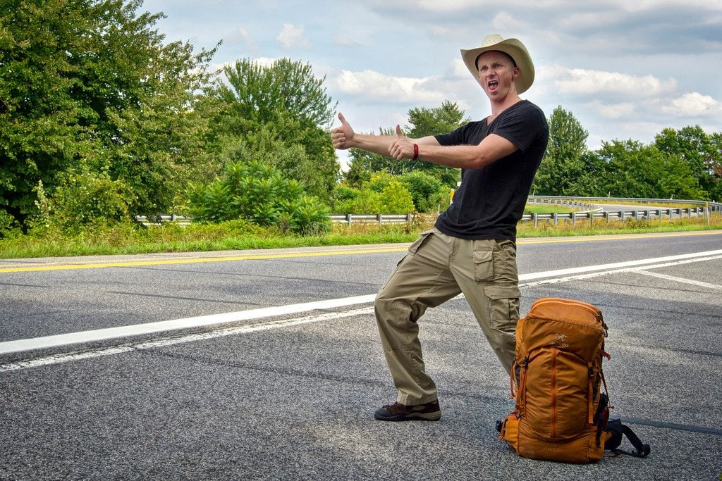
§ 63-3-1109. Hitchhiking
No person shall stand in a roadway for the purpose of soliciting a ride from the driver of any private vehicle.

Slide 58
§ 63-3-1111. White canes or guide dogs
(1) Whenever a pedestrian is crossing or attempting to cross a public street or highway, at or near an intersection or crosswalk, guided by a guide dog or carrying in a raised or extended position a cane or walking stick which is metallic or white in color, or white tipped with red, the driver of every vehicle approaching in said intersection or crosswalk shall take such precautions as may be necessary to avoid injuring or endangering such pedestrian, and if injury or danger to such pedestrian can be avoided only by bringing his vehicle to a full stop, he shall bring his said vehicle to a full stop. The word “vehicle,” when used in this section, does not include a train operated on railroad tracks.
(2) Nothing contained in this section shall be construed to deprive any totally or partially blind or otherwise incapacitated person, not carrying such a cane or walking stick or not being guided by a dog, of the rights and privileges conferred by law upon pedestrians crossing streets or highways. The failure of such totally or partially blind or otherwise incapacitated person to carry a cane or walking stick or to be guided by a guide dog upon the streets, highways or sidewalks of this state, shall not be held to constitute or be evidence of contributory negligence.
(3) It shall be unlawful for any person, unless totally or partially blind or otherwise incapacitated, while on any public street or highway, to carry in a raised or extended position a cane or walking stick which is metallic or white in color, or white tipped with red.
(4) The violation of any provision of this section shall be punishable by a fine of not more than twenty-five dollars ($25.00) or by imprisonment in the county jail for not more than ten (10) days.
Notes:
The driver has a duty to take precautions
A totally, partially blind or otherwise incapacitated person can use the pedestrian crossing without a guide. If they are injured, it will not equal contributory negligence
A person who is not blind or incapacitated cannot use the cane

Slide 59
§ 63-3-1113. Safety zones
No vehicle shall at any time be driven through or within a safety zone.

Slide 60
Article 25 – reckless or careless driving & misc. rules
§ 63-3-1201. Willful or wanton disregard
Any person who drives any vehicle in such a manner as to indicate either a willful or a wanton disregard for the safety of persons or property is guilty of reckless driving. Reckless driving shall be considered a greater offense than careless driving.
Every person convicted of reckless driving shall be punished upon a first conviction by a fine of not less than Five Dollars ($5.00) nor more than One Hundred Dollars ($100.00), and on a second or subsequent conviction he may be punished by imprisonment for not more than ten (10) days or by a fine of not exceeding Five Hundred Dollars ($500.00), or by both.
Notes:
Examples: Driving well above the speed limit.
Not using turn signals when turning or changing lanes.
Driving under the influence.
Texting or talking on the phone.
Refusing to stop at Stop signs and/or red lights.
Failing to turn on lights while driving at night or in rainy conditions.

Slide 61
§ 63-3-1213. Careless or imprudent driving
Any person who drives any vehicle in a careless or imprudent manner, without due regard for the width, grade, curves, corner, traffic and use of the streets and highways and all other attendant circumstances is guilty of careless driving. Careless driving shall be considered a lesser offense than reckless driving.
Every person convicted of careless driving shall be punished by a fine of not less than Five Dollars ($5.00) nor more than Fifty Dollars ($50.00).

Slide 62

Bicycles

Slide 63
§ 63-3-207
Bicyclists, animal riders or drivers
(1) This article applies to bicycles whenever they are operated upon any roadway or highway, or upon any path set aside for the exclusive use of bicycles.
(2) A person riding a bicycle upon a roadway has all of the rights and is subject to all of the duties applicable to the driver of a vehicle, except as may be otherwise provided in this article.

Slide 64
John Paul Frerer Bicycle Safety Act
§ 63-3-1303
Application; rights and duties of bicyclists
(1) This article applies to bicycles whenever they are operated upon any roadway or highway, or upon any path set aside for the exclusive use of bicycles.
(2) A person riding a bicycle upon a roadway has all of the rights and is subject to all of the duties applicable to the driver of a vehicle, except as may be otherwise provided in this article.

Slide 65
§ 63-3-1305
Bicycle lane; defined; blocking; exception
(1) For purposes of this section, “bicycle lane” means a portion of the roadway or a lane separated from the roadway that has been designated by striping, pavement markings and signage for the preferential or exclusive use of bicyclists.
(2) Whenever a bicycle lane has been provided adjacent to a roadway, the operator of a motor vehicle may not block the bicycle lane to oncoming bicycle traffic and shall yield to a bicyclist in the bicycle lane before entering or crossing the lane.
(3) This section does not apply to vehicles engaged in providing public services, including, but not limited to, fire engines, police vehicles, ambulances, public utility vehicles, waste management trucks and tow trucks.

Slide 66
§ 63-3-1307
Operation of bicycles; road usage; care required; single or double file (1 of 2)
(1) Every bicyclist operating a bicycle upon a roadway less than the normal speed of traffic shall ride as close as practicable to the right-hand curb or edge of the roadway except under any of the following conditions:
(a) When it is unsafe to do so;
(b) When overtaking and passing another bicycle or vehicle proceeding in the same direction;
(c) When preparing for or making a left turn at an intersection or into a private road or driveway;
(d) When proceeding straight in a place where right turns are permitted; and

Slide 67
§ 63-3-1307
Operation of bicycles; road usage; care required; single or double file (2 of 2)
(e) When necessary to avoid hazardous conditions, including, but not limited to, fixed or moving objects, vehicles, bicycles, pedestrians, animals, surface hazards or a lane of substandard width that makes it unsafe to continue along the right portion of the way. For purposes of this paragraph, “lane of substandard width” means a lane that is too narrow for a bicycle and a vehicle to travel safely side by side in the lane.
(2) When operating a bicycle upon a roadway, a bicyclist must exercise due care when passing or overtaking a vehicle that is standing or proceeding in the same direction.
(3) Bicyclists riding bicycles upon a roadway shall not ride more than two (2) abreast, except on paths or parts of roadways set aside for exclusive use of bicycles.

Slide 68
§ 63-3-1309
Passing
(1) While passing a bicyclist on a roadway, a motorist shall leave a safe distance of not less than three (3) feet between his vehicle and the bicyclist and shall maintain such clearance until safely past the bicycle.
(2) A motor vehicle operator may pass a bicycle traveling in the same direction in a nonpassing zone with the duty to execute the pass only when it is safe to do so.
(3) The operator of a vehicle that passes a bicyclist proceeding in the same direction may not make a right turn at any intersection or into any highway or driveway unless the turn can be made with reasonable safety.

Slide 69
§ 63-3-1311
Signaling turns
(1) A bicyclist shall indicate a right turn by extending the left arm upward, by raising the left arm to the square, or by extending the right arm horizontally to the right.
(2) A bicyclist shall indicate a left turn by extending the left arm horizontally.
(3) A bicyclist shall indicate stopping or decreasing speed by extending the left arm or the right arm downward.
(4) A bicyclist is not required to give the signals continuously, if the hand or arm is needed to control the bicycle.

Slide 70
§ 63-3-1313
Harassment of bicyclist; offense; penalties
It is unlawful to harass, taunt or maliciously throw an object at or in the direction of any person riding a bicycle.
A person convicted of a violation of this section shall be fined:
-$100.00 for the first offense,
-$500.00 for the second offense, and
-$2,500.00 and imprisonment in the county jail for seven (7) days for the third and subsequent offenses.

Slide 71
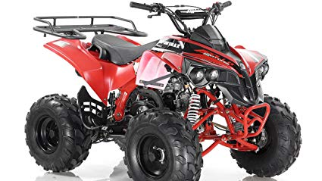
All Terrain Vehicles

Slide 72
ATV’s
Any vehicle meeting the definition of “motor vehicle” as provided in Section 63-3-103 of the Mississippi Code must have a tag, inspection sticker, proper equipment, and insurance.
Section 63-3-103(b) states: ” ‘Motor vehicle’ means every vehicle which is self-propelled and every vehicle which is propelled by electric power obtained from overhead trolley wires, but not operated upon rails.
All terrain vehicles are “motor vehicles” and therefor require tags(Section 27-19-1 et seq), proper equipment(Section 63-7-1 et seq) and insurance(Section 63-15-1 et seq).
2006 WL 2789826, (Miss. A.G. July 25, 2006)

Slide 73
Seatbelts

Slide 74
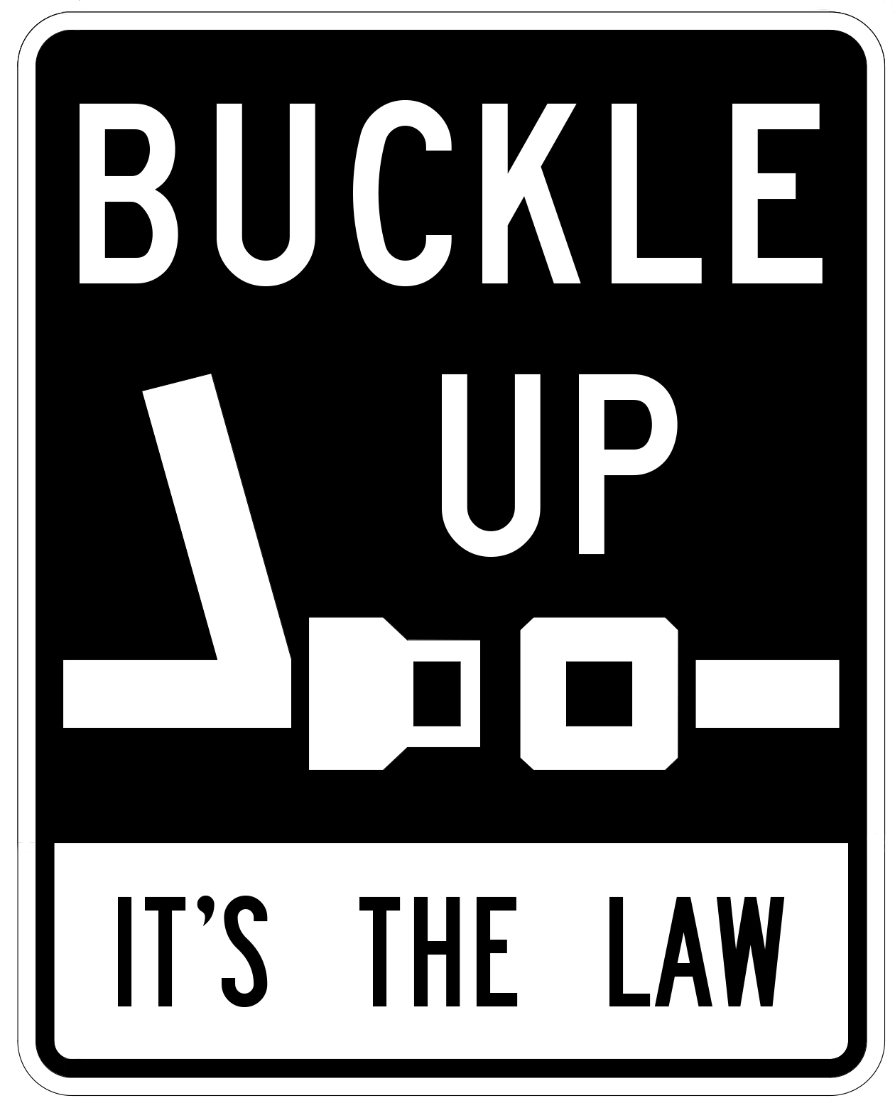
Seatbelt Violations
63-2-1(1)
-When a passenger motor vehicle
-is operated in forward motion
-on a public road, street or highway within this state,
-every operator and every passenger shall wear a properly fastened safety seat belt system,

Slide 75
Seatbelt Violations
63-2-1(2)
-“Passenger motor vehicle”
-a motor vehicle designed to carry 15 or fewer passengers - including the driver
-but does not include motorcycles, mopeds, all-terrain vehicles or trailers.

Slide 76
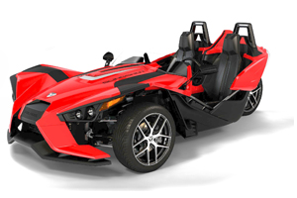
Seatbelt Violations
What about autocycles?
Autocycle motorists are required to wear seatbelts

Slide 77
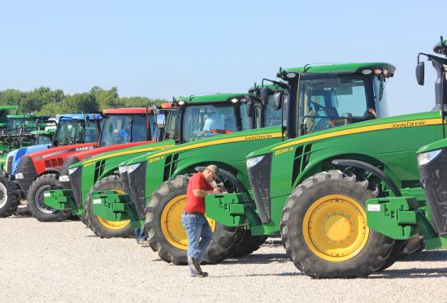
Seatbelt Violations
63-2-1(3)
Does not apply to:
-farm vehicles
-medical exemptees
-vehicle operated by US Postal Service/utility meter reader – while on duty

Slide 78
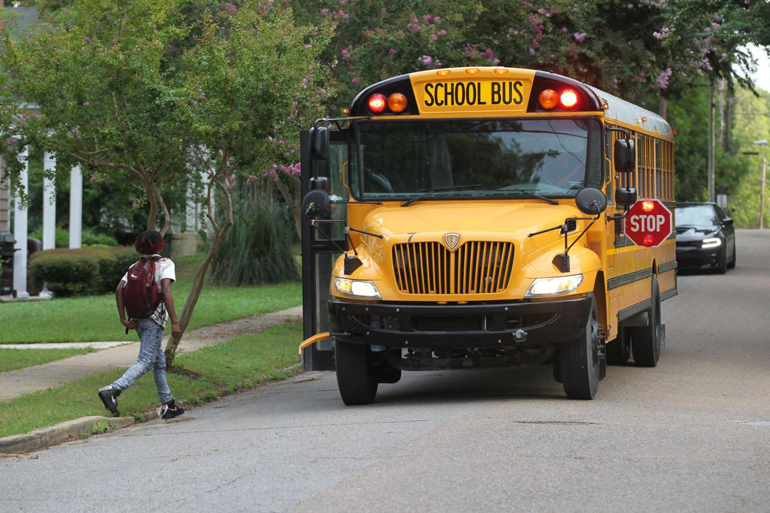
Seatbelt Violations
63-2-1(3)
Also does not apply to:
-buses
-a child required to be
restrained by child safety
restraint law

Slide 79
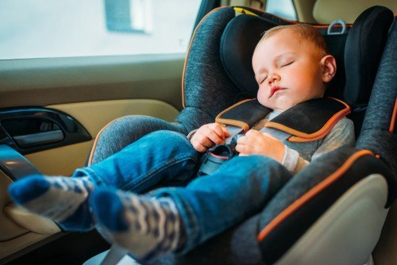
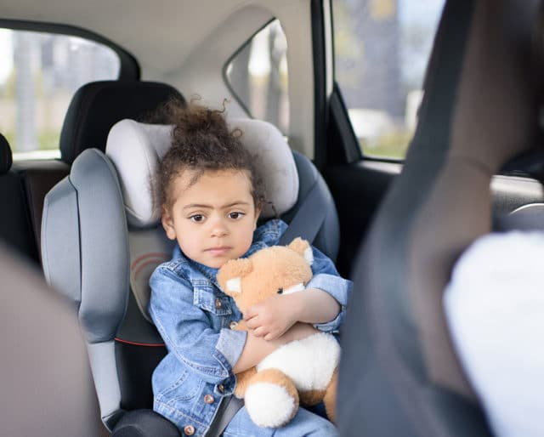
Child Passenger Restraints

Slide 80
Child Passenger Restraints
63-7-301
-Only applies to passenger motor vehicles as defined earlier in seatbelt law: 63-2-1.

Slide 81
Child Passenger Restraints
63-7-301
-Children under 4 years old
-shall use a child passenger restraint device

Slide 82
Child Passenger Restraints
63-7-301
-Children between 4 and 7 years old
-who measure less than 4’9” or weigh less than 65 pounds
-shall use a “belt positioning booster seat system”

Slide 83
Child Passenger Restraints
More than 2 children required to use a booster seat?
The 2 children in the rear use the shoulder belts with booster seat.
The child in the middle uses a lap belt only and is not required to have a booster seat .

Slide 84


